Slide 1
Stock Price Prediction
Most Suitable ML model for stock closing price

Slide 2
Background
Stock Market has always been a challenging task to be done due to volatility, numerous independent and dependant factors (including emotions) that will affect the daily closing stock price.
Stock Price Prediction using machine learning helps you discover the future value of company stock and other financial assets traded on an exchange. The entire idea of predicting stock prices is to gain significant profits.
Other factors involved in the prediction, such as physical and psychological factors, rational and irrational behavior etc. All these factors combine to make share prices dynamic and volatile. This makes it very difficult to predict stock prices with high accuracy.

Slide 3
Data
Data Source: Yahoo Finance API
NASDAQ: US Stock exchange
Company : Apple [NASDAQ: AAPL]
Period : 2019-01-01 to 2021-12-31 (3years)
Data Description:
Opening Value of the stock (beginning of the day)
Highest and Lowest values of that stock (daily)
Closing Value at the end of the day
Adjusted Close Value reflects the stock’s value (after dividends have been declared)
Total Volume of the stocks
Data Type:
Time Series Data

Slide 4
Why Choose Apple Inc.? (APPL)
Apple Inc has the concept of bringing an Ecosystem with its own range of Products and Services to both Consumers and Businesses
According to the Moltey Fool (as of 11th Dec 2021), there are 5 reasons to buy apple share:
iPhone's 90% loyalty rate – Brand Loyalty hence stable profit growth
745 million paid subscribers – 500% growth from 5 years ago
$191 billion in cash and equivalents – high capital in investing for R&D to develop better products
More resistant to inflation – less reliant on 3rd party chipmaker
$86 billion in buybacks – Apple to tighten its valuations

Slide 5
Why?
“Apple stock will continue to grow faster than economy” – CNBC.com (4th Jan 2021)
“Why We Are Raising Our Price Estimate For Apple Stock?”- Forbes.com (31st Jan 2021)
“ Is Apple Stock a major buy right now? The strategists say yes.” – Yahoo Finance (3rd Dec 2021)
“Apple takes Smartphone lead in Chin, heling drive record profit” – Wall Street Journal (28th Jan 2021)
Personal Favourite!! 😍

Slide 6
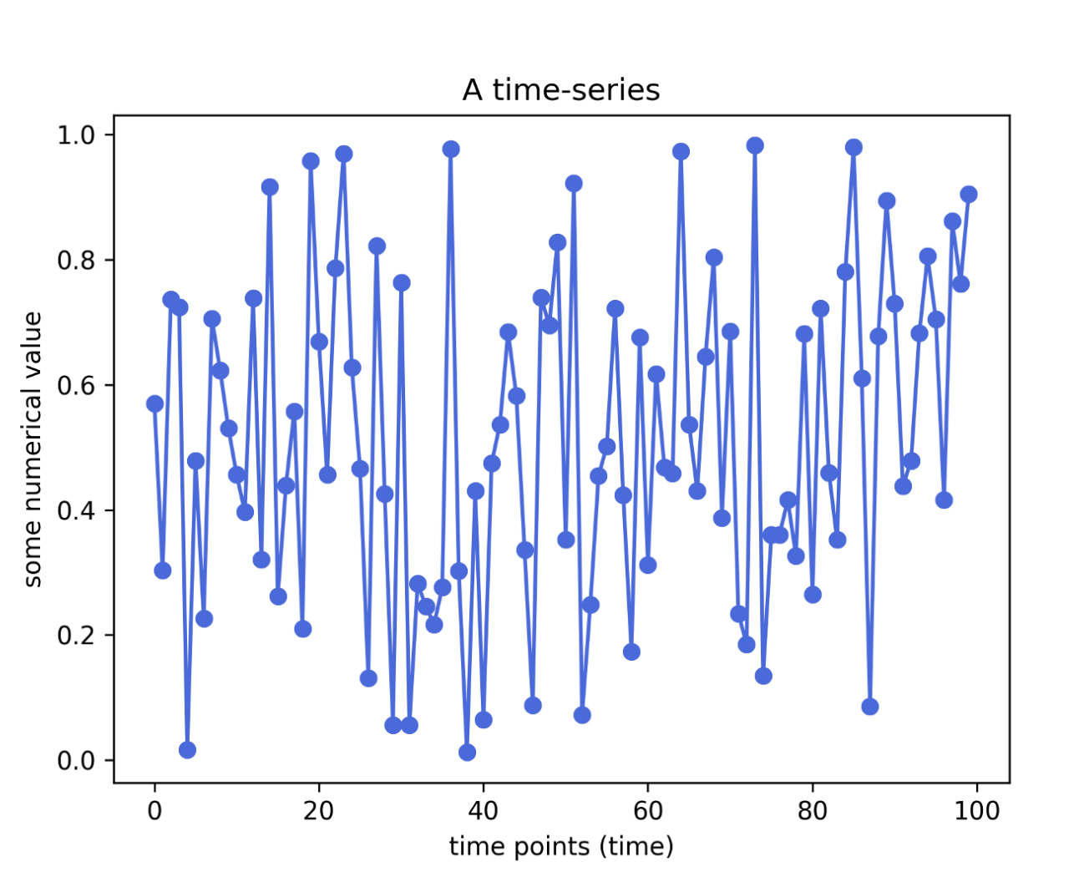
What is Time Series?
Sequence of observations taken sequentially in time
No natural ordering of observations
Other examples:
Ocean Tides
Weather
Health evolution metrics (eg body temperature)
Network logs

Slide 7
Strategy
Mid to Long term Investing – 3 years of History Price
Not focusing on short term (daily trading or weekly trading strategies)
Using the data from Yahoo Finance
Adding technical indicators of Moving Average to the dataset
Fundamental data of company is not included
Disclaimer: Any idea or prediction displayed in this presentation should not be considered as a guarantee strategy for stock price. The slides are only for presentation purposes and gathered from the general information researched.

Slide 8
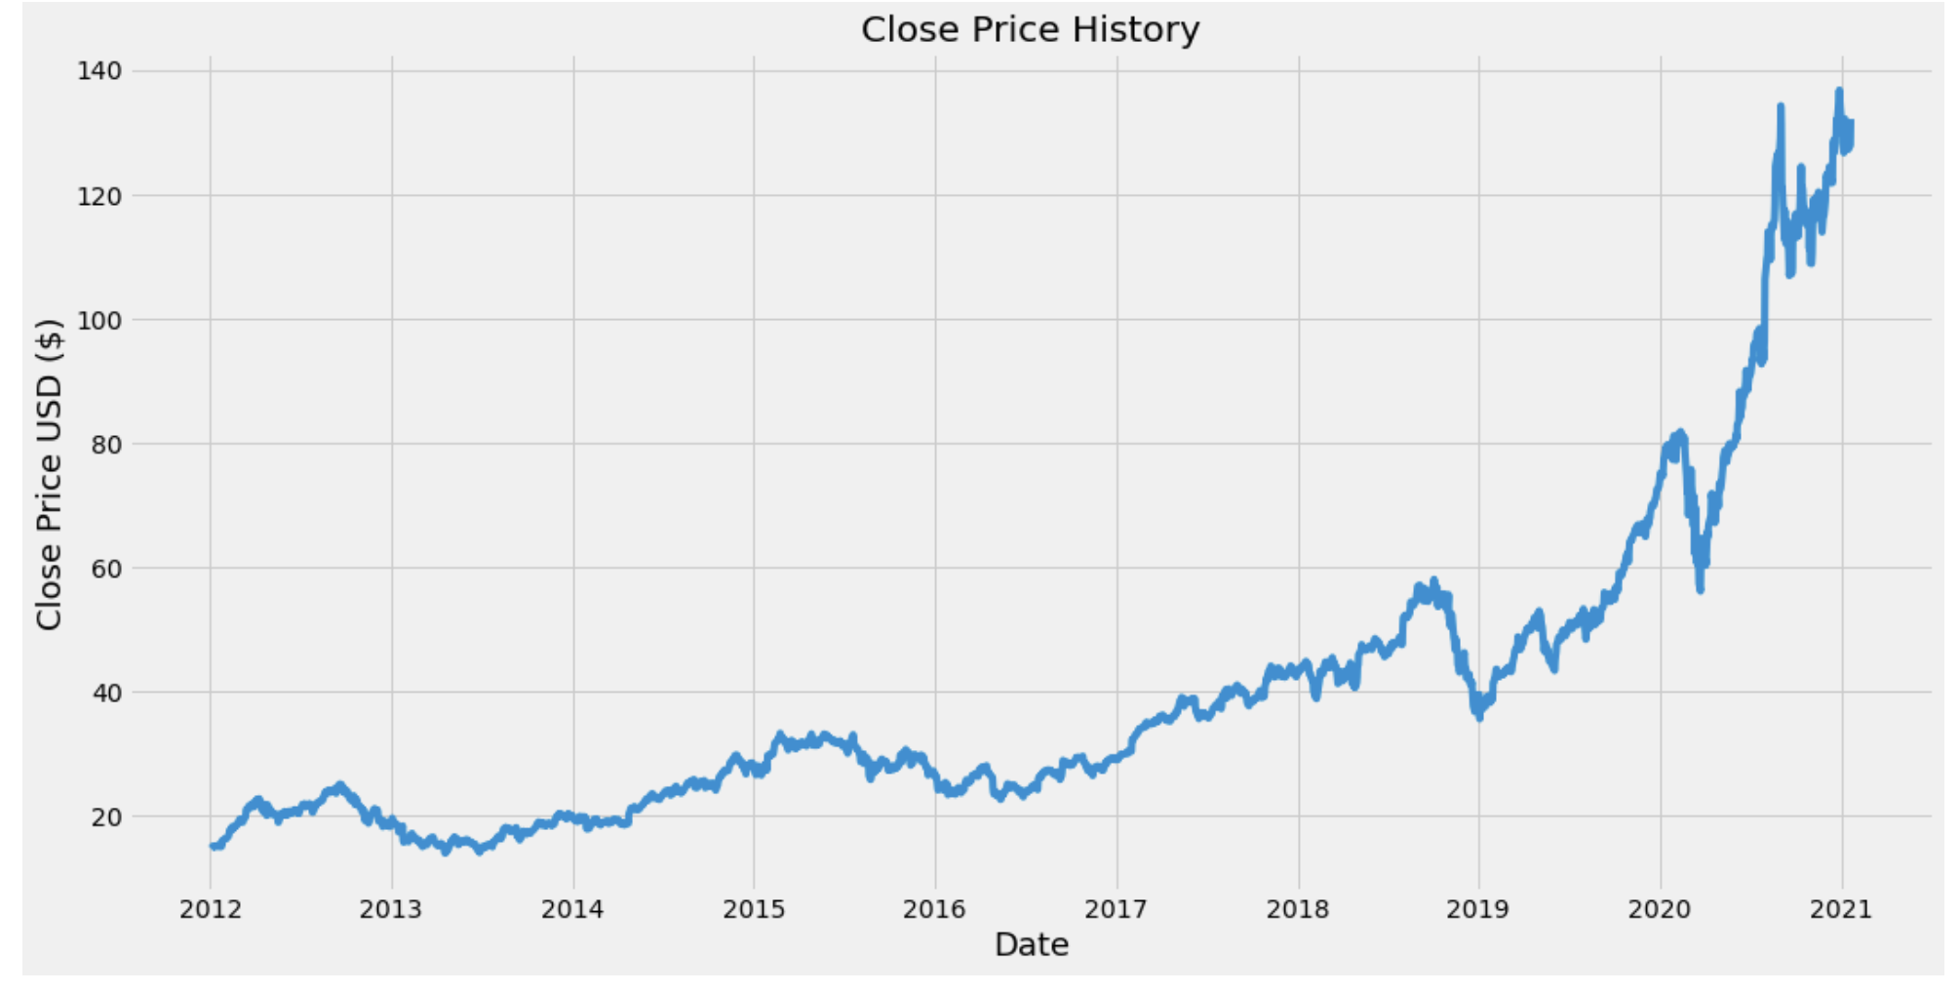
Closing Price (10 years)

Slide 9
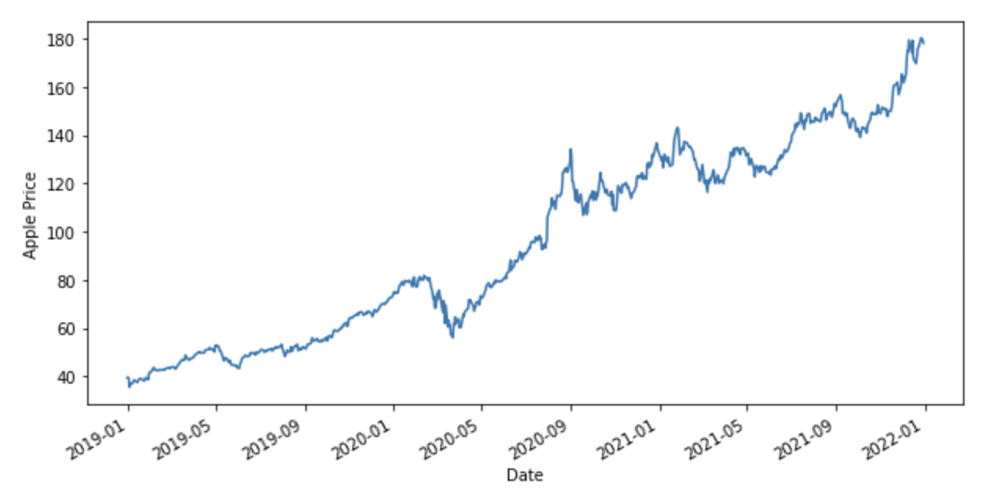
Closing Price (2019- 2022)

Slide 10
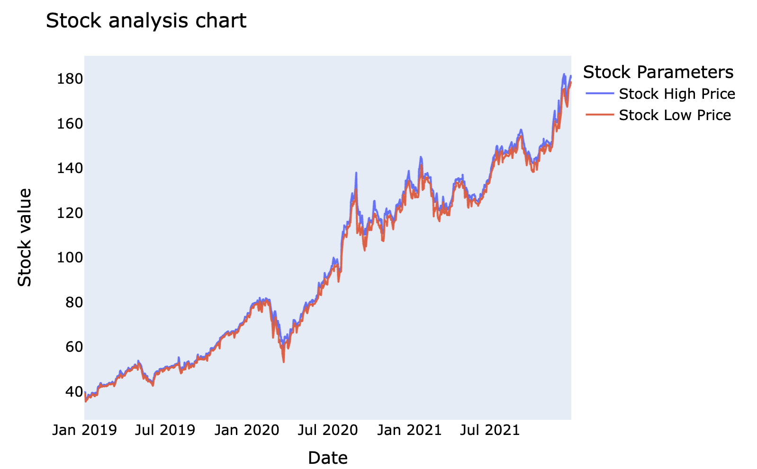
High-Low Price by Month

Slide 11
Moving Averages (MA)
Technical indicator that smooths out price trends by filtering out the “noise” from random short-term price fluctuations.
Identify trend direction (in general)
Support or Resistance for ”Buying” and ”Selling” Signals
Form the basis for other technical indicators such as the moving average convergence divergence (MACD) – Investopedia.com
In this project, 3 MA are created:
MA_50 : 50 days average
MA_100: 100 days average
MA_200: 200 days average

Slide 12
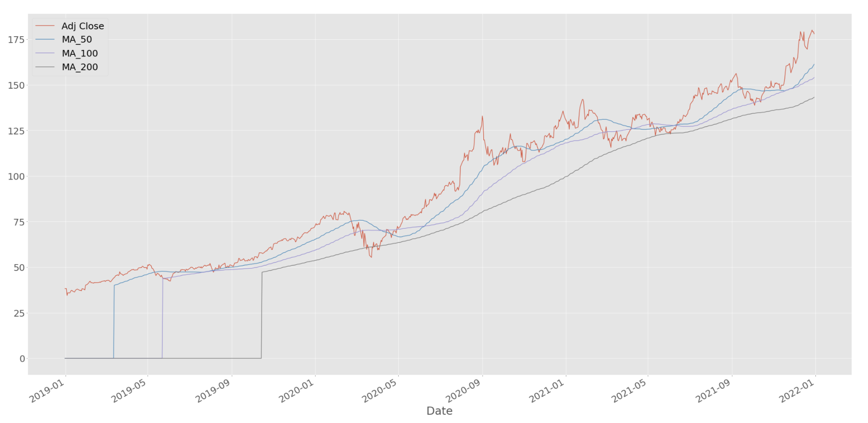
Moving Averages

Slide 13
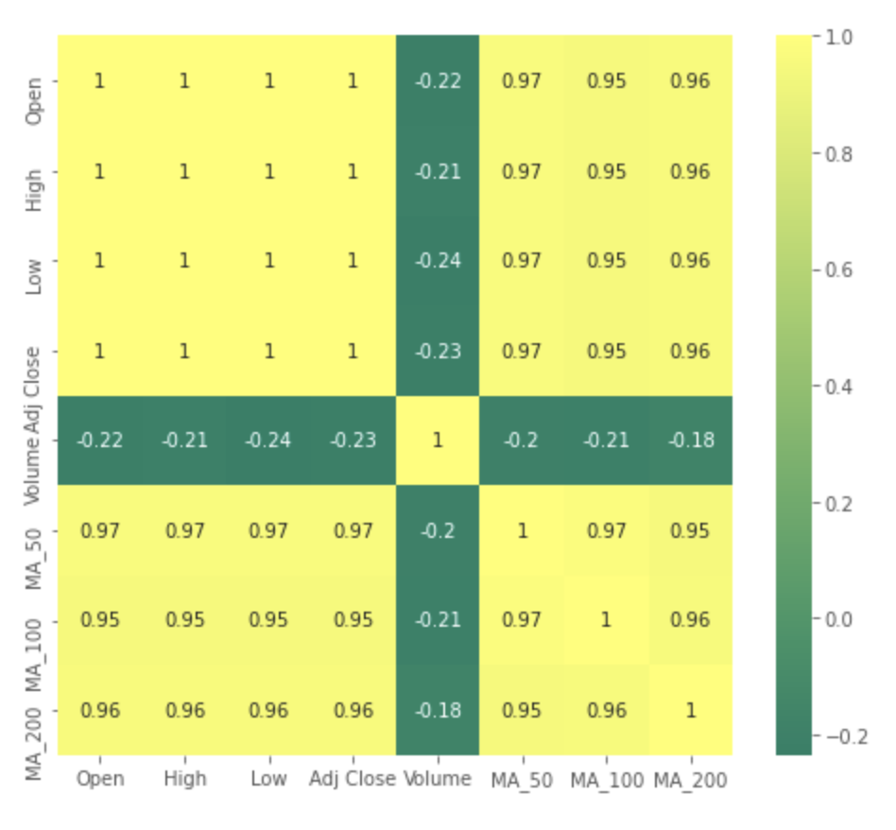
Heatmap
Correlation between the columns

Slide 14
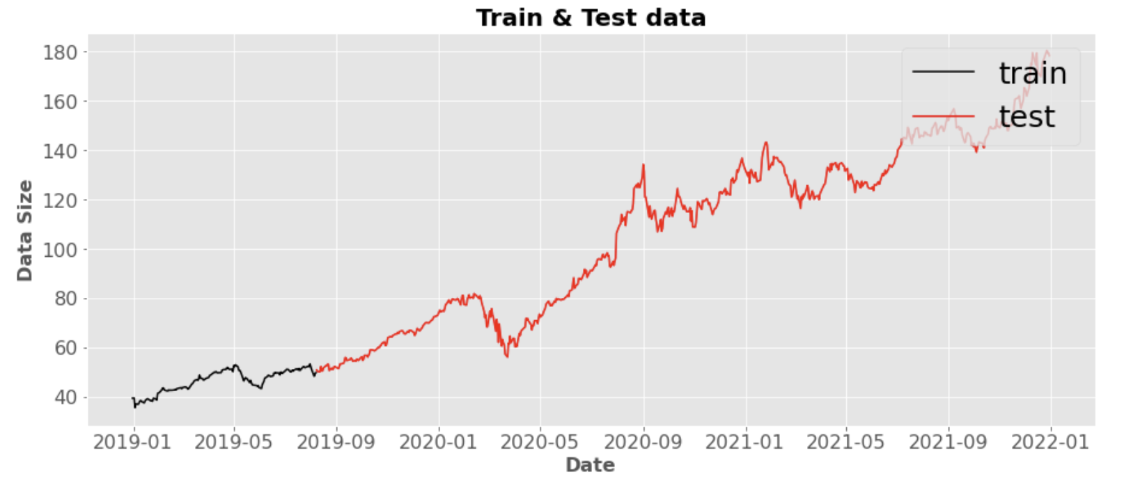
Train and Test Data
MinMax Scaler to scale the data
80% of the data is used for Testing

Slide 15
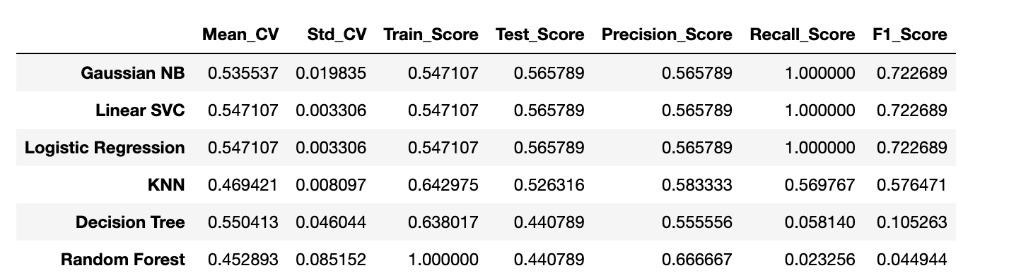
Model Comparison

Slide 16
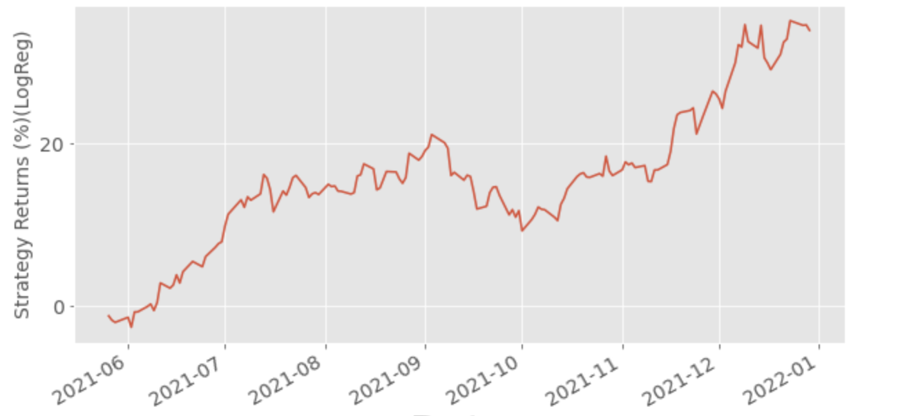
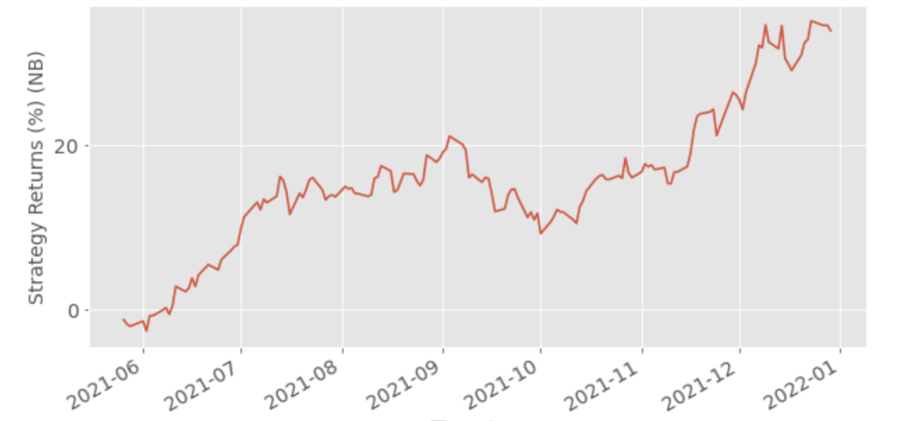
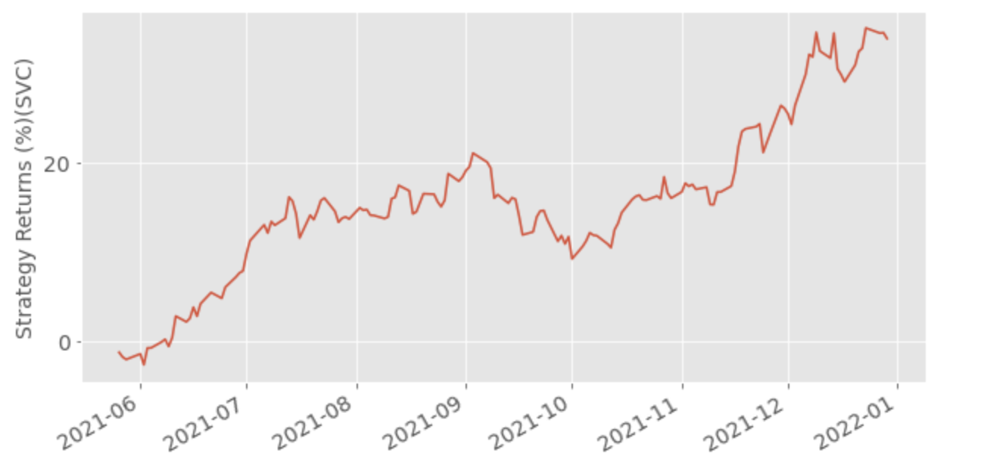
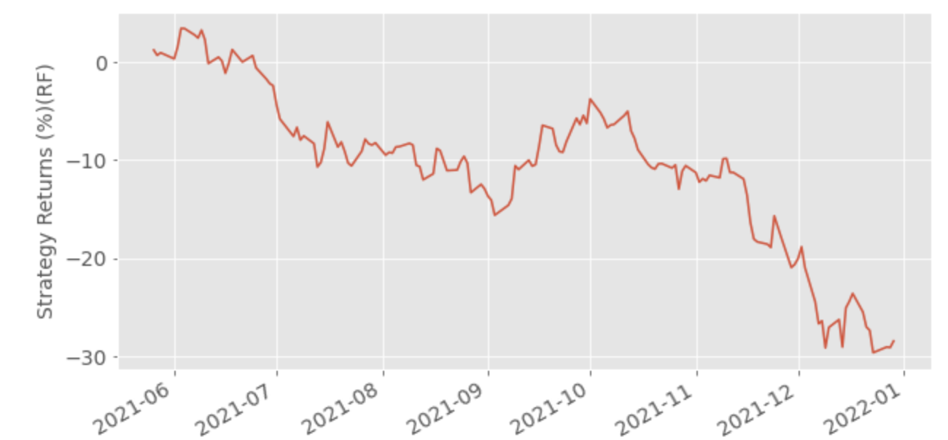
Predictions
Logistic Regression
GaussianNB
Linear SVC
Random Forest

Slide 17
Actual

Slide 18
Bagging, Boosting and Stacking
Model | Test Score | Test Score (Bag)
Logistic Regression | 0.537698 | 0.535714
Linear SVC | 0.503968 | 0.513888
Gaussian NB | 0.505952 | 0.505952
Decision Tree | 0.535714 | 0.531746
Stacking Models:
SVC
Random Forest
GaussianNB
Meta_classifer = Logistic Regression
Score ~ 50.6%

Slide 19
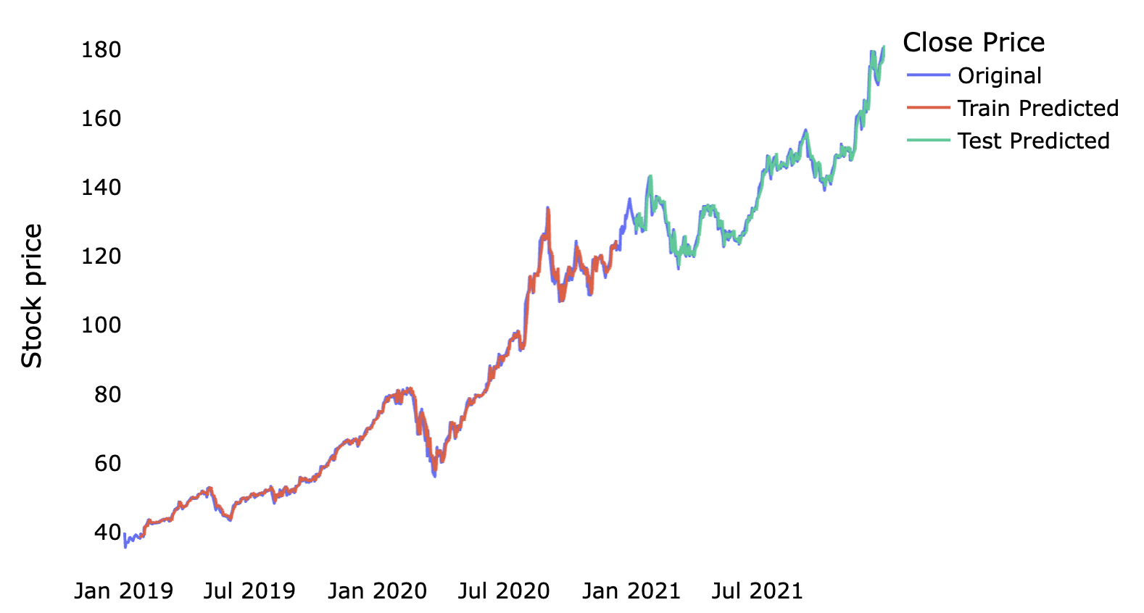
Linear Regression
Oversimplifies real-world problem by assuming linear relationship

Slide 20
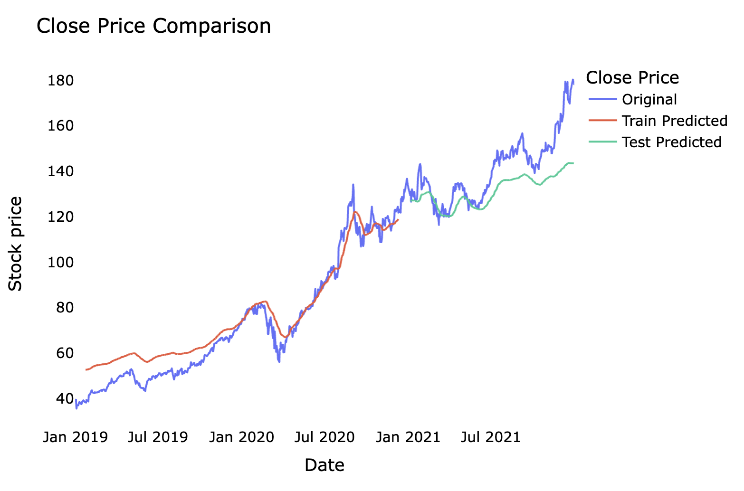
Support Vector Regressor
Higher prediction accuracy
Not suitable for large dataset –more prone to noise

Slide 21
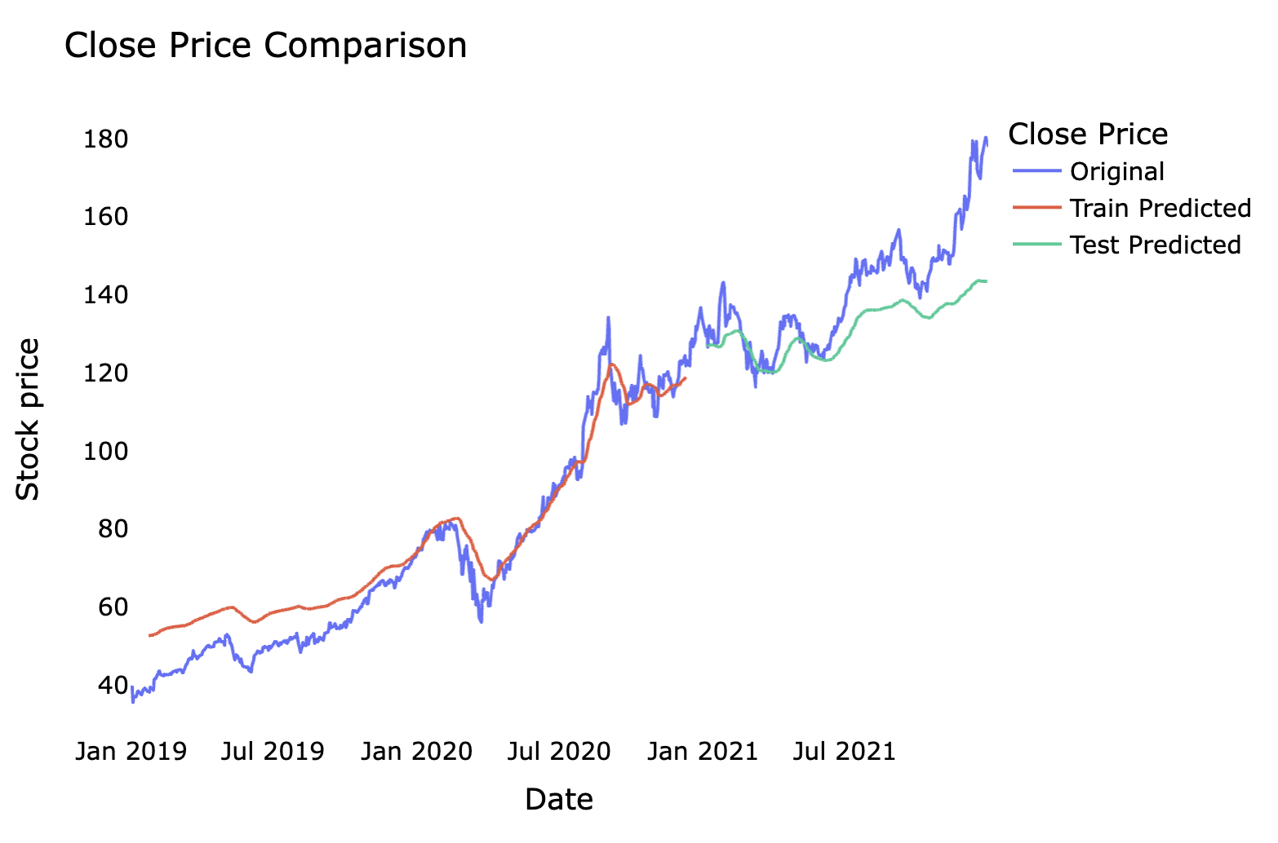
Random Forest Regressor
Prone to overfitting

Slide 22
Long Short Term Memory (LSTM)
One of the methods in Recurrent Neural Networks (RNN)
Process single data points (eg: images) and entire sequences of data (such as speech or video inputs)
Stores information over a period of time
Capable of predicting future values based on previously observed values
An LSTM Unit Consists of:
Cell: Memory cell
Forget Gate : what is to be “thrown away” from cell state
Input Gate: what is to be “stored” in the cell state
Output Gate : Outcome

Slide 23
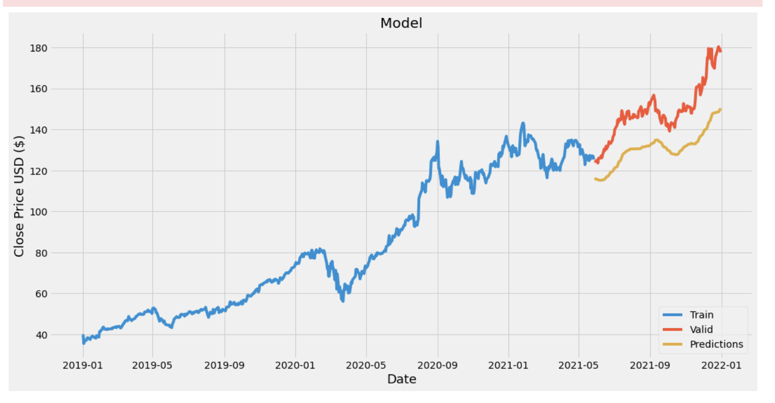
LSTM

Slide 24
Comparison
Model | RMSE - Train | MAE - Train | RMSE - Test | MAE - Test | Average
Linear Regression | 1.9872 | 3.9491 | 2.2243 | 1.6677 | 2.4570
SV Regressor | 6.5531 | 5.3373 | 14.4325 | 12.4014 | 9.6810
Random Forest Regressor | 0.8275 | 0.5511 | 15.7878 | 11.9214 | 7.2719
LSTM | 4.0294 | 2.8528 | 8.9852 | 7.9100 | 5.9443
Recap
Root Mean Squared Error (RMSE) : square root of the average square difference between prediction and actual
Mean Absolute Error (MAE) : Average magnitude of errors (without considering directions)
The lower the values, the better! ☺

Slide 25
Conclusion
Linear Regression: Tend to assume that all values are in linear relationships (not reliable in real-world example)
LSTM: Suitable for time-series data but subject to the historical data stored
Stock Prices can be volatile and not solely rely on data collected
Psychological factors such as emotions and news can affect stock prices as well
Fundamental data of companies can affect opinions to buy or sell the stock based on a certain price

Slide 26


Slide 27
Appendices
Simplilearn: https://www.simplilearn.com/tutorials/machine-learning-tutorial/stock-price-prediction-using-machine-learning#:~:text=Stock%20Price%20Prediction%20using%20machine%20learning%20helps%20you%20discover%20the,a%20hard%20task%20to%20do.
Analytics Vidhya: https://www.analyticsvidhya.com/blog/2021/10/machine-learning-for-stock-market-prediction-with-step-by-step-implementation/
Investopedia: https://www.investopedia.com/apple-stock-aapl-5075819
CNBC: https://www.cnbc.com/2022/01/04/apple-stock-will-continue-to-grow-faster-than-economy-investor-says.html
Motley Fool: https://www.fool.com/investing/2021/12/11/5-reasons-to-buy-apple-and-1-reason-to-sell/
Forbes: https://www.forbes.com/sites/greatspeculations/2022/01/31/why-we-are-raising-our-price-estimate-for-apple-stock/?sh=27ee71dc1b38
Yahoo Finance: https://sg.news.yahoo.com/is-apple-stock-a-major-buy-right-now-this-strategist-says-yes-185742460.html
Wall Street Journal: https://www.wsj.com/articles/apple-takes-smartphone-lead-in-china-helping-drive-record-profit-11643371201
Investopedia: https://www.investopedia.com/terms/n/nasdaq.asp
Investopedia (Moving Average) - https://www.investopedia.com/articles/active-trading/052014/how-use-moving-average-buy-stocks.asp
Linear Regression: https://www.analyticsvidhya.com/blog/2021/05/5-regression-algorithms-you-should-know-introductory-guide/#:~:text=In%20Machine%20Learning%2C%20we%20use,as%20a%20continuous%20numerical%20value.
Wikipedia: https://en.wikipedia.org/wiki/Long_short-term_memory
Time-series: https://towardsdatascience.com/lstm-time-series-forecasting-predicting-stock-prices-using-an-lstm-model-6223e9644a2f

